Slide 1
Chapter 12
SUPERVISED LEARNING
Categorization, Decision Trees
Part 1
Cios / Pedrycz / Swiniarski / Kurgan

Slide 2
Outline
What is Inductive Machine Learning?
- Categorization of ML Algorithms
- Generation of Hypotheses
Decision Trees
Rule Algorithms
- DataSqueezer
Hybrid Algorithms
  - CLIP4
  - Set Covering algorithm
© 2007 Cios / Pedrycz / Swiniarski / Kurgan

Slide 3
What is Inductive Machine Learning?
How do we understand learning?
We define it as the ability of an agent (like an algorithm) to improve its own performance based on past experience.
© 2007 Cios / Pedrycz / Swiniarski / Kurgan

Slide 4
What is Inductive Machine Learning?
Machine Learning (ML) can be also defined as the ability of a computer program:
to generate a new data structure that is different from an old one,
like production if…then… rules from input numerical or nominal data
© 2007 Cios / Pedrycz / Swiniarski / Kurgan

Slide 5
What is Inductive Machine Learning?
The key concept in inductive ML is that of a hypothesis, which is generated by a given algorithm
A hypothesis approximates some concept
We assume that only a teacher/oracle knows the true meaning of a concept and describes the concept, via means of examples, to a learner whose task is to generate a hypothesis that best approximates the concept
Example: concept of a “pneumonia” can be described by
(high fever, pneumonia)
(weak, pneumonia)
© 2007 Cios / Pedrycz / Swiniarski / Kurgan

Slide 6
What is Inductive Machine Learning?
Inductive ML algorithms generate hypotheses that approximate concepts;
hypotheses are often expressed in the form of production rules, and we say that
the rules “cover” the examples.
An example is covered by a rule when it satisfies all conditions of the IF part of the rule.
© 2007 Cios / Pedrycz / Swiniarski / Kurgan

Slide 7
What is Inductive Machine Learning?
Any inductive ML process is broken into two phases:
Learning phase, where the algorithm analyzes the training data and recognizes similarities among data objects. The result of this analysis is generation of a tree, or equivalent set of production rules.
Testing phase, where the rules are evaluated on new data, and when some performance measures are computed.
© 2007 Cios / Pedrycz / Swiniarski / Kurgan

Slide 8
What is Inductive Machine Learning?
ML algorithms can generate explicit rules, which can be inspected, learned from, or modified by users
This is an important advantage of ML over many other data mining methods.
© 2007 Cios / Pedrycz / Swiniarski / Kurgan

Slide 9
What is Inductive Machine Learning?
There are several levels (a pyramid) of knowledge:
Data
Warehouse
(carry original information)
(Extracted) Databases
(contain only useful information)
Knowledge / Information
(generated from a database, e.g. a set of ML rules)
Meta-knowledge
(knowledge about knowledge)
© 2007 Cios / Pedrycz / Swiniarski / Kurgan

Slide 10
Categorization of ML algorithms
ML algorithms work in one of two modes:
Supervised Learning / learning from examples
(all patterns have assigned target class)
Unsupervised Learning / learning from observation
(patterns do not have target class)
© 2007 Cios / Pedrycz / Swiniarski / Kurgan

Slide 11
Categorization of ML algorithms
Unsupervised Learning: learning system on its own discovers classes in the data by discovering common properties (with none or minimal help from the user)
Clustering – finding groups of similar examples
Association Rules - generation of rules describing frequently co-occurring items
© 2007 Cios / Pedrycz / Swiniarski / Kurgan

Slide 12
Categorization of ML algorithms
Incremental vs. non-incremental
In non-incremental learning all of the training examples are presented simultaneously (as a batch file) to the algorithm.
In incremental learning the examples are presented one at a time (or in groups) and the algorithm improves its performance based on the new examples without the need of re-training.
Most ML algorithms are non-incremental.
© 2007 Cios / Pedrycz / Swiniarski / Kurgan

Slide 13
Categorization of ML algorithms
Any supervised learning algorithm must be provided with a training data set. Let us assume that such a set S consists of M training data pairs, belonging to C classes:
S = {(xi ∈ cj) | i = 1,...,M; j = 1,...,C}
the training data pairs are often called examples, where xi is an n-dimensional pattern vector whose components are its features/attributes, and cj is a known class.
The mapping function f, c = f(x), is not known.
© 2007 Cios / Pedrycz / Swiniarski / Kurgan

Slide 14
Categorization of ML algorithms
Supervised Learning: known as inductive ML or learning from examples. The user, serving role of the teacher, provides examples describing each concept/class.
Rote learning – the system is “told” the correct rules
Learning by analogy – system is taught the correct response to a similar task; system needs to adapt to the new situation
© 2007 Cios / Pedrycz / Swiniarski / Kurgan

Slide 15
Categorization of ML algorithms
Case-based learning - the learning system stores all the cases it has studied so far along with their outcomes. When a new case is encountered the system tries to adapt to this new case by comparing with the stored previous behavior.
Explanation-based learning - the system analyzes a set of example solutions in order to determine why each was successful (or not).
© 2007 Cios / Pedrycz / Swiniarski / Kurgan

Slide 16
Categorization of ML algorithms
Conceptual clustering – is different from classical clustering because it is able to deal with nominal data.
Conceptual clustering consists of two tasks:
1) finding clusters in a given data set, and
2) characterization (labeling) that generates a concept description for each cluster found by clustering.
© 2007 Cios / Pedrycz / Swiniarski / Kurgan

Slide 17
Categorization of ML algorithms
Inductive vs Deductive Learning
Deduction infers information that is a logical consequence of the information stored in the data. It is provably correct if the data describing some domain are correct.
Induction infers generalized information, or knowledge, from the data, by searching for regularities among the data.
It is correct for the given data but only plausible outside of the data.
© 2007 Cios / Pedrycz / Swiniarski / Kurgan

Slide 18
Categorization of ML algorithms
Structured vs Unstructured Algorithms
In learning hypotheses (approximations of concepts) there is a need to choose a description language.
There are two basic types of domains: structured and unstructured.
An example belonging to an unstructured domain is usually described by an <attribute, value> pair. Description languages applicable to unstructured domains are: decision trees, production rules, and decision tables (used in rough sets).
For domains having an internal structure often a first-order calculus language can be used.
© 2007 Cios / Pedrycz / Swiniarski / Kurgan

Slide 19
Generation of Hypotheses
target
DECISION | CONDITION1 | CONDITION2 | INDEX
A | low | normal | 2
A | low | normal | 3
A | normal | normal | 3
A | normal | low | 2
A | normal | low | 1
B | low | high | 4
B | low | low | 4
B | high | normal | 4
A | normal | low | 2
A | normal | normal | 2
A | normal | normal | 2
A | normal | normal | 3
A | low | normal | 1
B | normal | high | 4
B | high | low | 4
B | high | normal | 4
A | normal | low | 4
A | low | normal | 2
A | low | normal | 2
A | normal | normal | 4
A | normal | normal | 2
B | low | high | 4
B | high | low | 4
B | high | normal | 4
© 2007 Cios / Pedrycz / Swiniarski / Kurgan

Slide 20
Generation of Hypotheses
target
DECISION | CONDITION1 | CONDITION2 | INDEX
A | low | normal | 2
A | low | normal | 3
A | normal | normal | 3
A | normal | low | 2
A | normal | low | 1
B | low | high | 4
B | low | low | 4
B | high | normal | 4
A | normal | low | 2
A | normal | normal | 2
A | normal | normal | 2
A | normal | normal | 3
A | low | normal | 1
B | normal | high | 4
B | high | low | 4
B | high | normal | 4
A | normal | low | 4
A | low | normal | 2
A | low | normal | 2
A | normal | normal | 4
A | normal | normal | 2
B | low | high | 4
B | high | low | 4
B | high | normal | 4
RULES for DECISION: A (4 rules)
1. IF CONDITION1 = normal AND CONDITION2 = normal THEN DECISION = A
2. IF INDEX = 2 THEN DECISION = A
3. IF CONDITION1 = normal AND CONDITION2 = low THEN DECISION = A
4. IF CONDITION1 = low AND CONDITION2 = normal THEN DECISION = A
RULES for DECISION: B (3 rules)
1. IF CONDITION1 = high AND INDEX = 4 THEN DECISION = B
2. IF CONDITION1 = low AND INDEX = 4 THEN DECISION = B
3. IF CONDITION1 = normal AND CONDITION2 = high AND INDEX = 4 THEN DECISION = B
© 2007 Cios / Pedrycz / Swiniarski / Kurgan

Slide 21
Generation of Hypotheses
DECISION | CONDITION1 | CONDITION2 | INDEX
A | low | normal | 2
A | low | normal | 3
A | normal | normal | 3
A | normal | low | 2
A | normal | low | 1
B | low | high | 4
B | low | low | 4
B | high | normal | 4
A | normal | low | 2
A | normal | normal | 2
A | normal | normal | 2
A | normal | normal | 3
A | low | normal | 1
B | normal | high | 4
B | high | low | 4
B | high | normal | 4
A | normal | low | 4
A | low | normal | 2
A | low | normal | 2
A | normal | normal | 4
A | normal | normal | 2
B | low | high | 4
B | high | low | 4
B | high | normal | 4
ASSOCIATION RULES (no “decision” target)
1. DECISION = B AND INDEX = 4
2. CONDITION1 = normal AND CONDITION2 = normal AND INDEX = 2
3. CONDITION2 = normal AND INDEX = 3
4. DECISION = A AND INDEX = 2
etc.
© 2007 Cios / Pedrycz / Swiniarski / Kurgan

Slide 22









Generation of Hypotheses
Information System
IS = < S, Q, V, f >
where
S is a finite set of examples S = {e₁, ..., e_{i}, ..., e_{M}}
M is the number of examples
Q is a finite set of features Q = {F₁, ..., F_{j}, ..., F_{n}}
n is the number of features
is a set of feature values
is the domain of feature
a value of feature
is an information function such that
for every and
© 2007 Cios / Pedrycz / Swiniarski / Kurgan

Slide 23
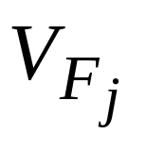
Generation of Hypotheses
Information System
The set S is often called the learning/training data set.
It is a subset of the entire universe, known only to the teacher/oracle, and is defined as a Cartesian product of all feature domains (j=1,2…n).
© 2007 Cios / Pedrycz / Swiniarski / Kurgan

Slide 24
Generation of Hypotheses
A travel agency tries to learn which customers generate the most profit based on the following data:
1. Type of a call: local, long distance, international.
2. Language fluency of a customer: fluent, fluent with accent, speaks badly, foreign language only.
3. Ticket type: local (0-250 miles), short distance (250-1000 miles), long distance (over 1000 miles).
4. Age of a customer: 1st range: 18-25 years, 2nd range: 25-40 years, 3rd range: 40-60 years, 4th range: 60-80 years, 5th range: 80 and older.
The fifth feature, the decision attribute, is:
5. Purchase ticket: Buy/Not buy
(Buy: positive examples, Not buy: negative examples)
© 2007 Cios / Pedrycz / Swiniarski / Kurgan

Slide 25
Generation of Hypotheses
S | F1 | F2 | F3 | F4 | F5
Example | Type of call | Lang. fluency | Ticket type | Age | Decision attribute
E1 E2 | Local (1) Local (1) | Fluent (1) Fluent (1) | Long (3) Local (1) | Very young (1) Old (4) | Buy (1) Buy (1)
E3 | Long dist. (2) | Not fluent (3) | Short (2) | Very old (5) | Buy (1)
E4 E5 E6 | Intern. (3) Local (1) Local (1) | Accent (2) Fluent (1) Not fluent (3) | Long (3) Short (2) Short (2) | Very old (5) Middle (3) Very young (1) | Buy (1) Buy (1) Not buy (2)
E7 E8 E9 | Intern. (3) Intern. (3) Local (1) | Fluent (1) Foreign (4) Not fluent (3) | Short (2) Long (3) Long (3) | Middle (3) Young (2) Middle (3) | Not buy (2) Not buy (2) Not buy (2)
IF (F1= 1) AND (F2= 1) THEN F5 = 1
IF Type of call = Local AND Language fluency = Fluent THEN Decision = Buy
© 2007 Cios / Pedrycz / Swiniarski / Kurgan

Slide 26
Generation of Hypotheses
Information System for the example:
S = {e₁,…e₉}, M = 9
Q = {F₁, …F₅}, n = 5
V_{F1}= {Local, Long dist., International}
V_{F2} = {Fluent, Accent, Not fluent, Foreign}
V_{F3} = {Local, Short, Long}
V_{F4} = {Very young, Young, Middle, Old, Very old}
V_{F5} = {Buy, Not buy}
© 2007 Cios / Pedrycz / Swiniarski / Kurgan

Slide 27
Generation of Hypotheses
It is important to establish a balance between the rules’ generalization and specialization in order to generate a set of rules that have good predictive power.
A general rule is one that covers several training (positive) examples.
A specialized rule, on the other hand, may cover, in an extreme case only one example.
© 2007 Cios / Pedrycz / Swiniarski / Kurgan

Slide 28
Generation of Hypotheses
The rules can be generalized, or specialized, by using the following common techniques:
Replacing constants with variables (a more general rule is obtained by replacing constants, in rules that have the same outcome, by a variable, and thus merging them into one rule)
IF F1= krystyna THEN student
IF F1= konrad THEN student
IF F1= karol THEN student
can be replaced by a more general rule:
IF F1= Soic THEN student
© 2007 Cios / Pedrycz / Swiniarski / Kurgan

Slide 29
Generation of Hypotheses
Disjuncts are used for rule generalization, and conjuncts are used for rule specialization:
IF F1= 1 AND F2= 5 THEN class1
is a more specialized rule (uses conjunct AND) than
IF F1= 1 THEN class1
(OR)
IF F2= 5 THEN class1
(the last two rules are in disjunction, i.e., are connected by a disjunct OR (that is never written explicitly; thus any collection of production rules is always ORed).
© 2007 Cios / Pedrycz / Swiniarski / Kurgan

Slide 30
Generation of Hypotheses
Moving up in a hierarchy for generalization
If there is a known hierarchy the generalization can be performed by replacing the conditions involving the knowledge at the lower level by the common conditions involving the knowledge at the higher level.
IF F1= canary THEN class = sing
IF F1= nightingale THEN class = sing
can be replaced (if hierarchy of “singbirds” exists) by
IF F1= singbird THEN class = sing
Chunking
Is based on the assumption that given the goal every problem encountered on the way to this goal can be treated as a sub-goal.
Then we can generate rules for each of the sub-goals, and put them together.
© 2007 Cios / Pedrycz / Swiniarski / Kurgan

Slide 31
Decision Trees
Decision tree consists of nodes and branches connecting the nodes. The nodes located at the bottom of the tree are called leaves, and indicate classes.
The top node in the tree, called the root, contains all training examples that are to be divided into classes.
All nodes, but leaves, in the tree are called decision nodes since they specify a specific decision to be performed at this node based on a single feature.
Each decision node has a number of children nodes, equal to the number of values a given feature assumes.
© 2007 Cios / Pedrycz / Swiniarski / Kurgan

Slide 32
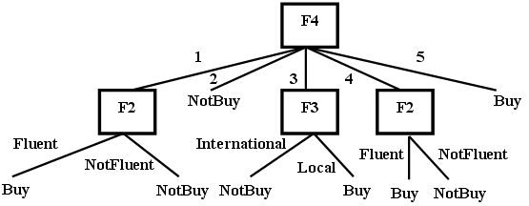
Decision Trees
© 2007 Cios / Pedrycz / Swiniarski / Kurgan

Slide 33
Decision Trees
All decision tree algorithms are based on Hunt’s fundamental algorithm of concept learning.
This algorithm is an embodiment of a method used by humans when learning simple concepts:
it is done by finding key distinguishing features between two categories, represented by the positive and negative (training) examples.
© 2007 Cios / Pedrycz / Swiniarski / Kurgan

Slide 34
Decision Trees
Hunt’s algorithm
Given: A set of training examples, S
1. Select the most discriminatory (significant) feature
2. Split the entire set, S, located at the root of the tree, into several subsets using the selected feature. The number of children nodes originating from the root is equal to the number of values the selected feature takes on.
3. Recursively find the most significant feature for each subset generated in step 2 and top-down split it into subsets. If each subset contains examples belonging to one class only (a leaf node) then stop, otherwise go to step 3.
Result: The decision tree from which classification rules can be extracted
© 2007 Cios / Pedrycz / Swiniarski / Kurgan

Slide 35
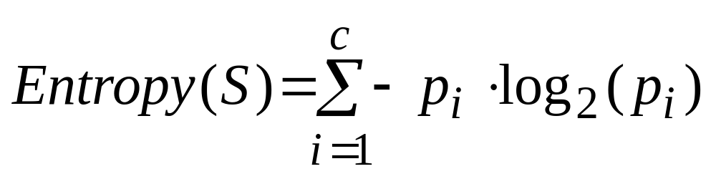
Decision Trees
Shannon’s entropy is used as a criterion for selecting the most significant/discriminatory feature:
where: p_{i} - proportion of the examples belonging to the i^{th} class.
© 2007 Cios / Pedrycz / Swiniarski / Kurgan

Slide 36
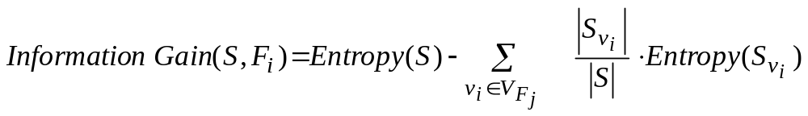
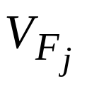
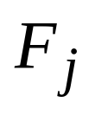
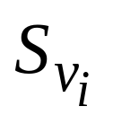

Decision Trees
Information Gain measures expected reduction in entropy caused by knowing the value of a feature F_{j} :
where
is a set of all possible values of feature
is a subset of S, for which feature
has value v_{i}.
Information Gain is used to select the best (reducing the entropy by the largest amount) feature at each step of growing a decision tree.
© 2007 Cios / Pedrycz / Swiniarski / Kurgan

Slide 37
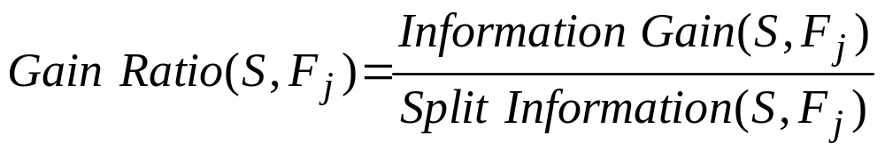
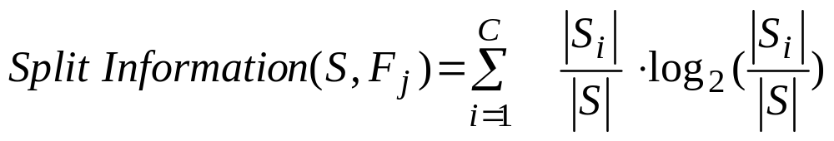
Decision Trees
To compensate for the bias of the Information Gain (for cases
with many outcomes) a measure called Gain Ratio is used:
where:
Split Information is the entropy of S with respect to values of feature F_{j}.
In a situation when two or more features have the same value of
Information Gain the feature that has less number of values is selected.
Using gain ratio results in generation of smaller trees.
© 2007 Cios / Pedrycz / Swiniarski / Kurgan

Slide 38
Decision Trees
ID3 algorithm
Given: A set of training examples, S
1. Create the root node containing the entire set S
2. If all examples are positive, or negative, then stop: decision tree has one node
3. Otherwise (general case)
  3.1 Select feature F_{j} that has the largest Information Gain value
  3.2 For each value v_{i} from the domain of feature F_{j}:
a) add a new branch corresponding to this feature value v_{i}, and a new node, which stores all the examples that have value v_{i} for feature F_{j}
b) if the node stores examples belonging to one class only then it becomes a leaf node, else below this node add a new sub-tree, and go to step 3
Result: A decision tree
© 2007 Cios / Pedrycz / Swiniarski / Kurgan

Slide 39
Decision Trees
ID3 algorithm uses inductive bias during learning,
namely, it prefers small over large decision trees.
Decision tree, in fact, consists of disjunctions of conjunctions of the feature values, and thus can be represented by an equivalent set of
IF…THEN… rules
© 2007 Cios / Pedrycz / Swiniarski / Kurgan

Slide 40
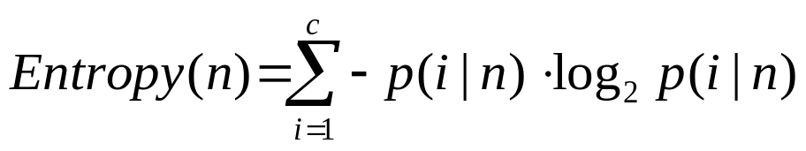
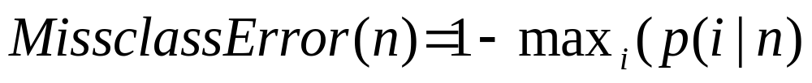
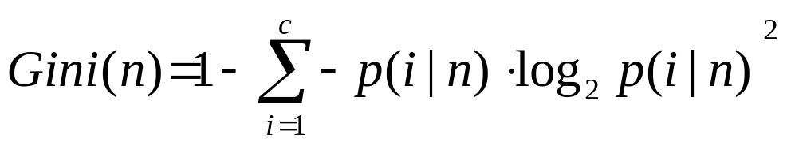
Decision Trees
Other measures for finding the most discriminatory feature for
building decision trees are:
where p(i│n) denotes fraction of examples from class i at node n.
Instead of entropy we can use misclassification error:
or Gini:
© 2007 Cios / Pedrycz / Swiniarski / Kurgan

Slide 41
Decision Trees
S | F1 | F2 | F3 | F4 | F5
Example | Type of call | Lang. fluency | Ticket type | Age | Decision attribute
E1 E2 | Local (1) Local (1) | Fluent (1) Fluent (1) | Long (3) Local (1) | Very young (1) Old (4) | Buy (1) Buy (1)
E3 | Long dist. (2) | Not fluent (3) | Short (2) | Very old (5) | Buy (1)
E4 E5 E6 | Intern. (3) Local (1) Local (1) | Accent (2) Fluent (1) Not fluent (3) | Long (3) Short (2) Short (2) | Very old (5) Middle (3) Very young (1) | Buy (1) Buy (1) Not buy (2)
E7 E8 E9 | Intern. (3) Intern. (3) Local (1) | Fluent (1) Foreign (4) Not fluent (3) | Short (2) Long (3) Long (3) | Middle (3) Young (2) Middle (3) | Not buy (2) Not buy (2) Not buy (2)
IF (F1= 1) AND (F2= 1) THEN F5 = 1
IF Type of call = Local AND Language fluency = Fluent THEN Decision = Buy
© 2007 Cios / Pedrycz / Swiniarski / Kurgan

Slide 42
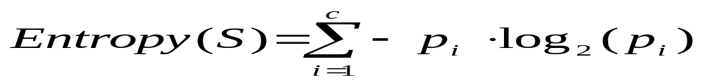
Decision Trees
Example for travel agency:
We calculate for attribute F1 and each of its values the following:
Having the above we calculate the information gain for feature F1 as:
© 2007 Cios / Pedrycz / Swiniarski / Kurgan

Slide 43
Decision Trees
We perform similar calculations for features F2, F3, and F4, and choose the “best” (in terms of the largest value of the information gain) feature.
This feature is F4, and is used at the root of the tree to split the examples into subsets, which are stored at the children nodes.
Next, at each child node we perform the same calculations to find the best feature, at this level of the decision tree, to split the examples on, until the leaf nodes contain examples belonging to one class only
© 2007 Cios / Pedrycz / Swiniarski / Kurgan

Slide 44
Decision Trees
IF (F4=1) AND (F2=Fluent(1)) THEN F5=Buy
IF (F4=3) AND (F3=Local(1)) THEN F5=Buy
IF (F4=4) AND (F2=Fluent(1)) THEN F5=Buy
IF (F4=5) THEN F5=Buy (covers 2 examples)
© 2007 Cios / Pedrycz / Swiniarski / Kurgan

Slide 45
Decision Trees
Methods to overcome overfitting in decision tree algorithms:
Generation of several decision trees instead of one
Windowing
Pruning
After pruning there should be no significant loss of the classification accuracy; pruning helps to generate more general rules.
© 2007 Cios / Pedrycz / Swiniarski / Kurgan

Slide 46
Decision Trees
Pruning can be done during the process of tree growing - pre-pruning:
we stop tree-growing when it is determined that no attribute will significantly increase the Gain.
Pruning also can be also done after the entire tree is grown –
post-pruning:
some of the branches are removed according to criterion of no significant loss of the rules accuracy on the training data.
© 2007 Cios / Pedrycz / Swiniarski / Kurgan

Slide 47
Decision Trees
The extreme case of pre-pruning was introduced by Holte who proposed an algorithm called 1RD for building decision trees that are only one-level deep.
He has shown that the classification performance of such trees is comparable with other more complex algorithms.
© 2007 Cios / Pedrycz / Swiniarski / Kurgan

Slide 48
Decision Trees
Windowing
is a technique to deal with large data
Windowing divides training data into subsets (windows) from which several decision trees are grown.
Then the best rules extracted from these trees are chosen - according to the lowest error-rate on the validation data set.
© 2007 Cios / Pedrycz / Swiniarski / Kurgan

Slide 49
Decision Trees
C4.5 algorithm is an extension of ID3 that allows for:
using continuous input values, by using build-in front-end discretization algorithm
growing trees on data with missing features values
© 2007 Cios / Pedrycz / Swiniarski / Kurgan

Slide 50
Decision Trees
Advantages and disadvantages of decision trees:
they reveal relationships between the rules (that can be written out from the tree). Because of this it is easy to see the structure of the data,
produce rules that best describe all the classes in the training data set,
are computationally simple,
may generate very complex (long) rules, which are very hard to prune,
generate large number of corresponding rules. Their number can become excessively large unless pruning techniques are used to make them more comprehensible,
require large amounts of memory to store the entire tree for deriving the rules.
© 2007 Cios / Pedrycz / Swiniarski / Kurgan

Slide 51
Decision Trees
Decision trees and rule algorithms always create decision boundaries that are parallel to the coordinate axes defined by the features
In other words, they create hypercube decision regions in high-dimensional spaces
An obvious remedy for this shortcoming is to have an algorithm that is able to place a decision boundary at any angle. This idea is used in the Continuous ID3 (CID3) neural network algorithm
© 2007 Cios / Pedrycz / Swiniarski / Kurgan

Slide 52
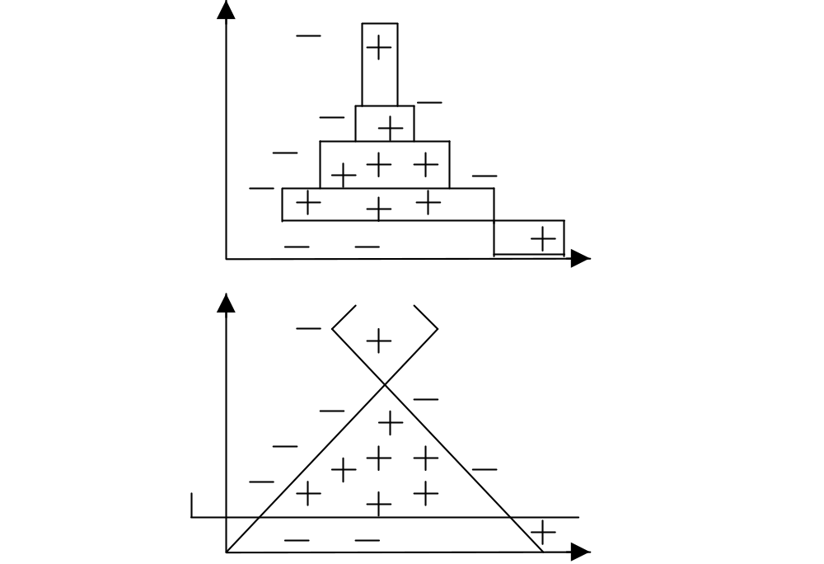
Decision Trees
© 2007 Cios / Pedrycz / Swiniarski / Kurgan

